Slide 1
2017 BCGWA Regional Meeting
Hydraulic Connection
and
Environmental Flow Needs (EFNs)
October 20, 2017
Vernon, BC
Nicole Pyett Ryan Whitehouse Michael Epp
Regional Hydrogeologist Aquatic Ecologist Water Stewardship Officer

Slide 2
Outline | Hydraulic Connectivity | Licensing Application | Environmental Flow Needs | Summary
OUTLINE:
Hydraulic connectivity
Water Science Series: Determining the Likelihood of Hydraulic Connection
Hydraulic connection in the Okanagan
Licensing application process
Water license reviews
Consideration of hydraulic connectivity/EFNs in a water license review
Environmental flow needs (EFNs)
Assessment of EFNs
Types of advice for Statutory Decision Makers (SDMs)
Summary and questions

Slide 3
Outline | Hydraulic Connectivity | Licensing Application | Environmental Flow Needs | Summary
“Hydraulic connection”, for the purpose of water allocation and use, means the reasonable likelihood that pumping of groundwater from a well will eventually result in a change in the flow of a stream or spring or change in the level of a lake, pond, wetland that overlies or borders the aquifer, over a time period and to an extent that the decision maker must take into account in considering the environmental flow needs of the stream or whether the rights of other authorized users on the stream are likely to be detrimentally affected.
Barlow and Leake, 2012

Slide 4
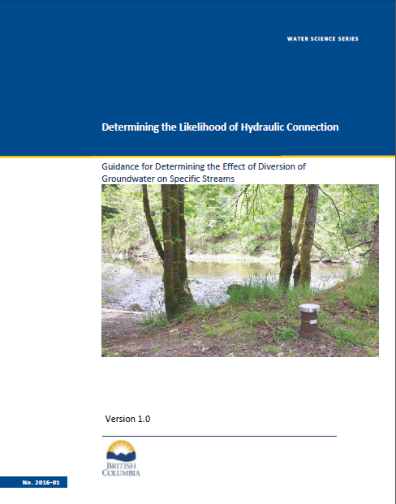
Outline | Hydraulic Connectivity | Licensing Application | Environmental Flow Needs | Summary
HYDRAULIC CONNECTIVITY

Slide 5
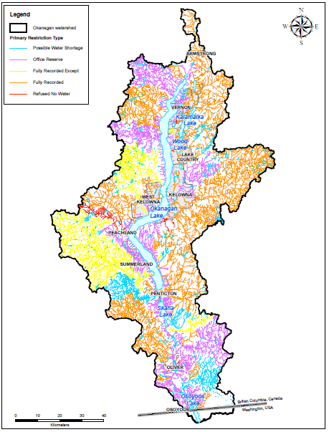
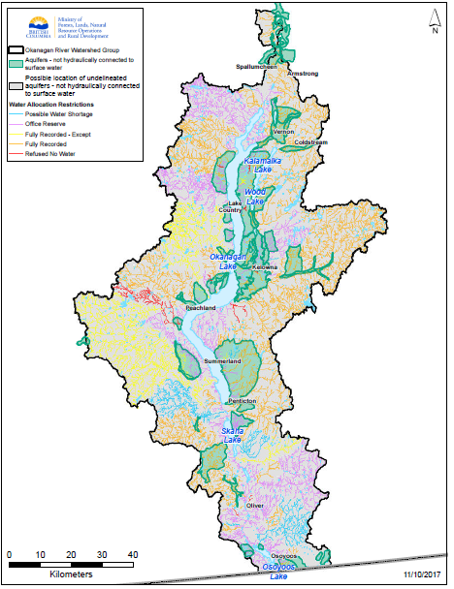
Outline | Hydraulic Connectivity | Licensing Application | Environmental Flow Needs | Summary

Slide 6
Outline | Hydraulic Connectivity | Licensing Application | Environmental Flow Needs | Summary
LICENSING APPLICATION PROCESS
Water licence applications are submitted through virtual FrontCounter BC (www.frontcounterbc.gov.bc.ca)
Applicants specify whether the application is for existing use or new use (before or after February 29, 2016).
Application is first reviewed by FCBC staff, who may contact applicant to provide additional information/clarification.
FCBC then forwards application to FLNR water staff for review. Water staff may get assistance from Regional Hydrologists
Technical documents are submitted to decision maker

Slide 7
Outline | Hydraulic Connectivity | Licensing Application | Environmental Flow Needs | Summary
LICENSING APPLICATION CONSIDERATIONS
Environmental Flow Needs (EFN)
Consultation with First Nations
Licensees on same source
Licensees on hydraulically connected or downstream sources
Existing restrictions and reserves
Land owners impacted by works
Referrals to local governments, other agencies
Priority date
Purpose and volume justification

Slide 8
Outline | Hydraulic Connectivity | Licensing Application | Environmental Flow Needs | Summary
CONSIDERING HYDRAULIC CONNECTIVITY
If groundwater pumping from a well has the likelihood of causing streamflow depletion, the decision maker must consider the environmental flow needs of a stream in deciding on an application, except where exemptions are identified in the regulations.
In the case of a new groundwater user where a technical assessment is required, assessment of hydraulic connection and determining effects of groundwater demand on affected streams will be completed by a professional with competency in hydrogeology (WSS Guidance 2016-08)
Applications for new groundwater use where the is likely hydraulic connection with a stream that has restrictions or is fully recorded would be addressed in the same manner as new surface water applications
Notes:
for Technical Assessment Requirements in Support of an Application for Groundwater Use in British Columbia

Slide 9
Outline | Hydraulic Connectivity | Licensing Application | Environmental Flow Needs | Summary
ENVIRONMENTAL FLOW NEEDS (Legislation)
Definition – “in relation to a stream, means the volume and timing of water flow required for the proper functioning of the aquatic ecosystem” (Water Sustainability Act, Section 1)
Water Sustainability Act requires that a decision maker must consider the environmental flow needs of a stream or an aquifer that is reasonably likely to be hydraulically connected when making a decision on an application (Section 15)
Water Sustainability Regulation details when applications may be exempted from the consideration of Environmental Flow needs (Section 16)

Slide 10
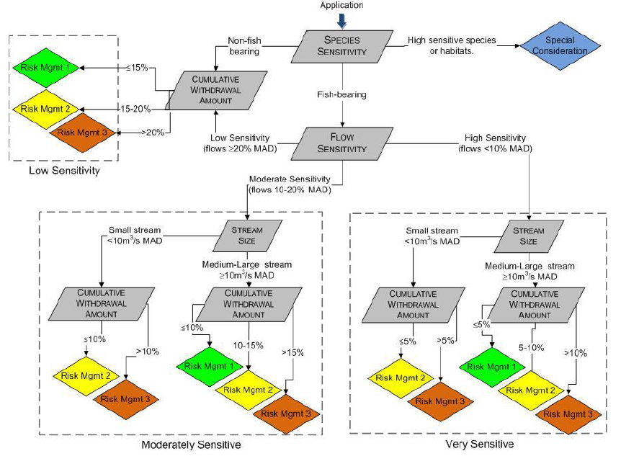
Outline | Hydraulic Connectivity | Licensing Application | Environmental Flow Needs | Summary
ENVIRONMENTAL FLOW NEEDS (Policy)
Notes:
The Provincial EFN policy provides a framework to assess the relative risk level associated with different water applications – does not provide a discharge volume that is an environmental flow need
Considers four different pieces of information 1) Presence of fish 2) Stream size 3) Average natural monthly discharge 4) Cumulative licensed demand by month
Places applications into 1 of four potential categories 1) Low Sensitivity 2) Moderate Sensitivity 3) Very Sensitiive and 4) Special Considertions (usually due the presence of species or habitats at risk
Just because a stream falls into a moderate or very sensitive range does not automatically mean that an application will be denied, it does suggest that the application could;
receive additional scrutiny and have risk management measures applied in the form of terms and conditions; or
In the event that risks cannot be reliably managed, the application could be denied
The EFN policy provides potential risk management measures for the different applications that fall within the different sensitivity levels

Slide 11
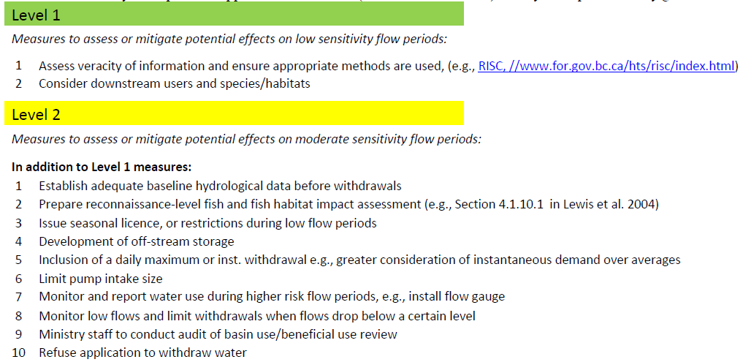
Outline | Hydraulic Connectivity | Licensing Application | Environmental Flow Needs | Summary

Slide 12
Outline | Hydraulic Connectivity | Licensing Application | Environmental Flow Needs | Summary
ENVIRONMENTAL FLOW NEEDS (“Considering EFNS”)
During an assessment of Environmental Flow Needs we attempt to answer 4 main questions
How much water is in the system naturally
How much water has been licensed
How much water is being consumed
How much water does the aquatic ecosystem require
Notes:
Important to make the distinction between residual and natural discharge (natural discharge is what would be available if no water was being used). Assumption: aquatic ecosystem in a particular stream has become adapted to the conditions present in a location
How much water has been licensed – primarily concerned with a consumptive licenses, this information is publicly available through water license searches.
How much water is being consumed – evaluates consumption on a weekly or monthly basis, represents an estimate of the amount of water this is actually being used throughout the year and potentially could be used if everyone turned on their pumps at the same time. Again this mainly focussed on consumptive licenses that are not back by storage.
How much water does the aquatic ecosystem require – In most situations we apply generic flow targets that are published to protect fish in the streams. These thresholds are presented in the form of a percentage of Mena Annual Discharge (eg. Juvenile fish in the summer require 20% of the Mean Annual Discharge). There are circumstances where these flow targets may not be appropriate – in these situations WO may ask for additional information or carry out a detailed assessment.

Slide 13
Outline | Hydraulic Connectivity | Licensing Application | Environmental Flow Needs | Summary
SUMMARY
Hydraulic connectivity considers the timing and magnitude of the impact
The decision maker must consider the EFN of a stream or an aquifer that is reasonably likely to be hydraulically connected when making a decision on an application.
Guidance documents:
Water Science Series: Determining the Likelihood of Hydraulic Connection
Water Science Series: Technical Assessment Requirements in Support of an Application for Groundwater Use in British Columbia

Slide 14
Outline | Hydraulic Connectivity | Licensing Application | Environmental Flow Needs | Summary
Nicole Pyett Ryan Whitehouse Michael Epp
Regional Hydrogeologist Aquatic Ecologist Water Stewardship Officer
Nicole.Pyett@gov.bc.ca Ryan.Whitehouse@gov.bc.ca Michael.Epp@gov.bc.ca

Slide 15
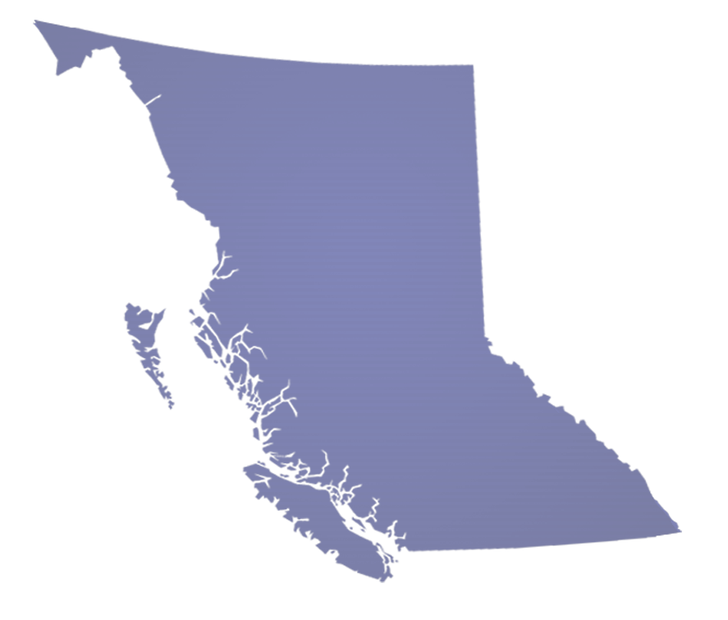
QUESTIONS?

